Slide 1
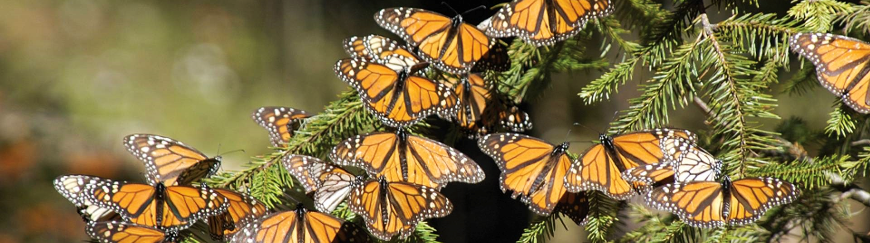
Monarch Butterflies in Peril: A Data-Driven Approach to Protecting Pollinators
Fig. 1: “13 Facts about Monarch Butterflies in North America.” Good Nature Travel Blog | Stories Are Made on Adventures, 16 Aug. 2022, www.nathab.com/blog/monarch-butterfly-facts/.
Hackers: Bella Griffith, Evan Griffith, Aishwarya Patel, Victor Robles Jr.
Beginner Track

Slide 2
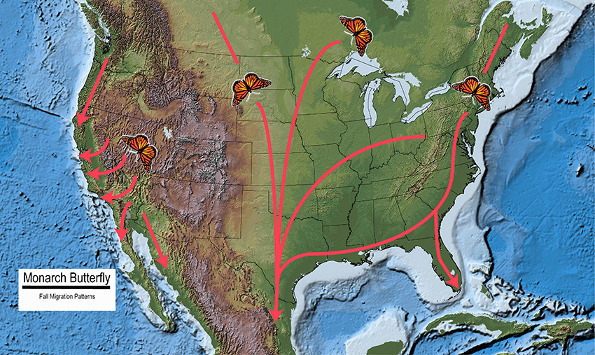
• Monarch butterfly populations are declining due to habitat loss, climate change, and pesticide use, impacting ecosystems and biodiversity.
• Monarchs rely on milkweed, and its reduction due to agricultural expansion, herbicides, and urban development is a major threat to their survival.
• Protecting monarchs is crucial for maintaining pollination services, biodiversity, and raising awareness of broader environmental issues, with their migration being ecologically and culturally significant.
About Monarch Butterflies
Fig. 2: Fall Monarch Butterfly Migration Pattern
“U.S. Forest Service.” Forest Service Shield, www.fs.usda.gov/wildflowers/pollinators/Monarch_Butterfly/migration/index.shtml. Accessed 5 Oct. 2024.
Gutierrez, Juan. "2024 Rowdy Datathon Data Challenge". Planned Obsolescence [PDF File], 7 October 2024. https://rowdydatathon.org/

Slide 3
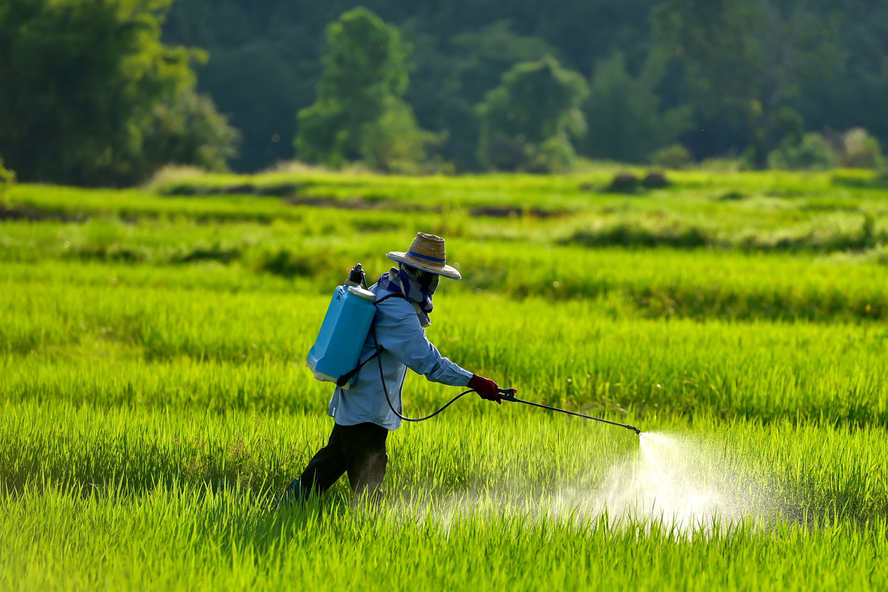
Pesticides are substances used to manage pests, regulate plants, and improve nitrogen stability, containing both active and inert ingredients to ensure effectiveness. The EPA reviews all pesticide ingredients to ensure they meet safety standards for human health and environmental protection before they can be used. EPA assessments consider potential health risks, environmental effects, and impacts on non-target organisms to ensure the safe use of pesticides.
WHAT ARE Pesticides?
Fig. 3: “Pesticide Exposure on Thai Farms Mapped by NIEHS-Funded Scientists (Environmental Factor, February 2022).” National Institute of Environmental Health Sciences, U.S. Department of Health and Human Services, factor.niehs.nih.gov/2022/2/papers/pesticide-exposure. Accessed 6 Oct. 2024.
EPA, Environmental Protection Agency, www.epa.gov/pesticides. Accessed 5 Oct. 2024.

Slide 4
TYPES OF PESTICIDES / HERBICIDES
Neonicotinoids
Neonicotinoids are toxic insecticides that harm both pests and beneficial insects, like bees, by attacking their nervous systems.
These systemic pesticides contaminate entire plants and persist in soil and water, damaging ecosystems.
Overuse of neonics, often unnecessary, worsens pest problems by killing beneficial insects.
Lindwall, Courtney. “Neonicotinoids 101: The Effects on Humans and Bees.” Effects of Neonicotinoids on Humans and Bees, 25 May 2022, www.nrdc.org/stories/neonicotinoids-101-effects-humans-and-bees.

Slide 5
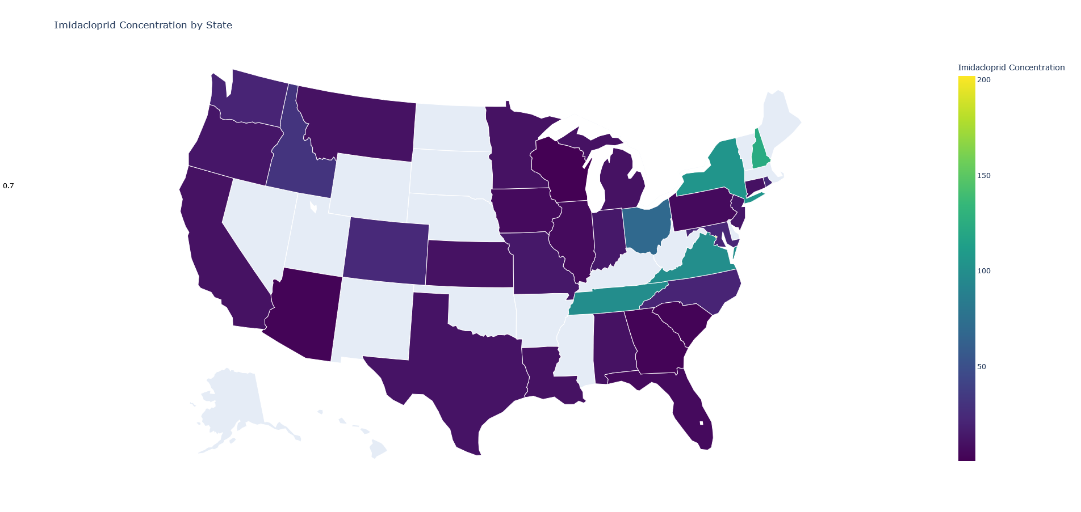
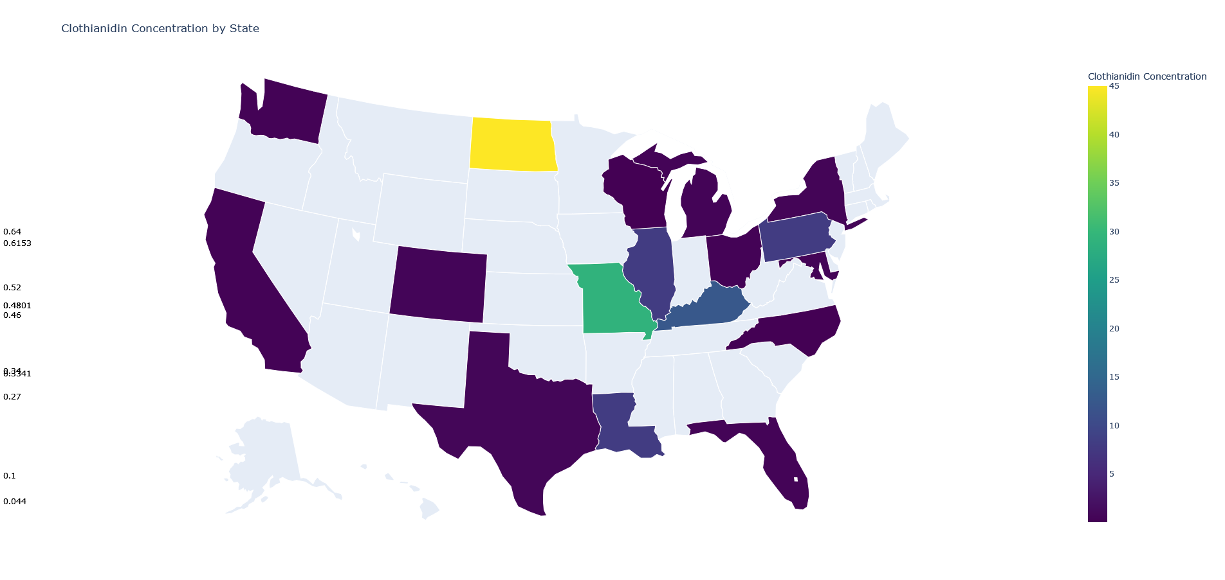
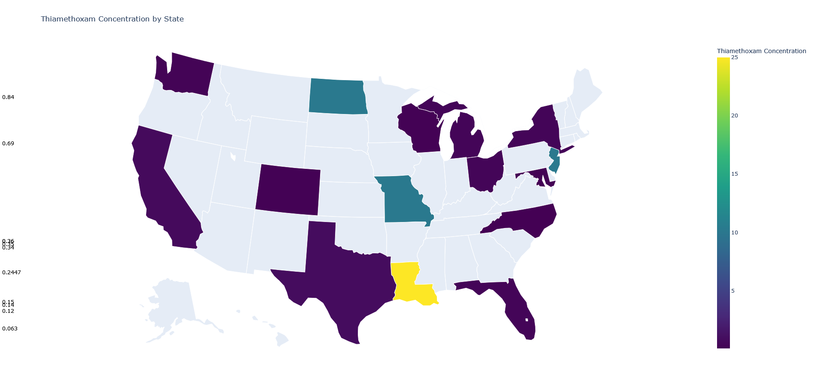


NEONICOTINOID EXAMPLES
Fig. 4: Imidacloprid
Fig. 5: Clothianidin
Imidacloprid is an insecticide designed to mimic nicotine, a natural toxin found in plants like tobacco. It targets sucking insects, termites, certain soil insects, and fleas on pets. Since its introduction in the U.S. in 1994, it has been widely used for pest control.
In Wisconsin, clothianidin is a neonicotinoid insecticide used on crops like corn and soybeans and in residential pest control products. Registered by the EPA in 2003, it is found in over 30 products, originally manufactured by Bayer CropScience, with others like BASF and DuPont.
Fig. 6: Thiamethoxam
Thiamethoxam is a neonicotinoid insecticide that mimics nicotine, targeting insects by binding to their nicotinic acetylcholine receptors, leading to paralysis. While used in crops like corn and soybeans, it has been linked to honeybee colony collapse disorder, prompting bans in Europe.

Slide 6
TYPES OF PESTICIDES / HERBICIDES
II. Organophosphates
Organophosphates are pesticides that harm pollinators by damaging their nervous systems, contributing to colony collapse disorder.
Despite reduced use after 2001, they still account for 33% of insecticides, impairing pollinators' foraging abilities.
Regulations, such as the 2022 EPA ban on chlorpyrifos, aim to reduce their harmful impact.
“Organophosphates Fact Sheet.” National Caucus of Environmental Legislators, 6 June 2023, www.ncelenviro.org/resources/organophosphates-fact-sheet/#:~:text=Organophosphates%20are%20a%20class%20of,landscaping%2C%20and%20mosquito%20management%20industries.

Slide 7
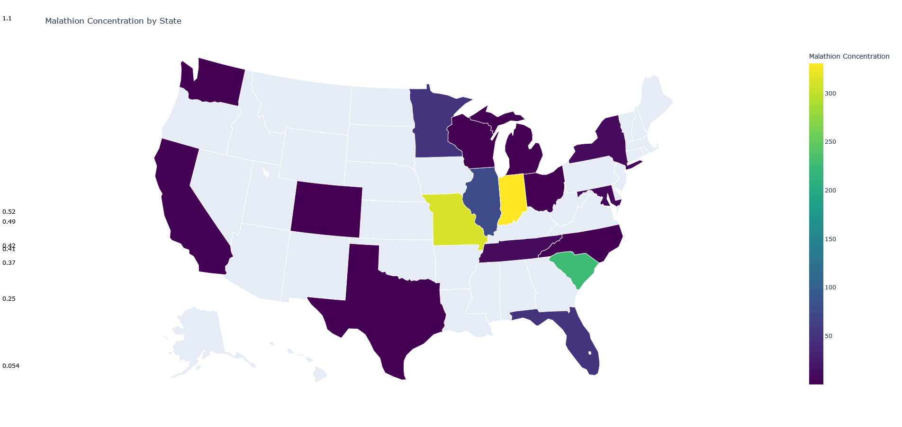
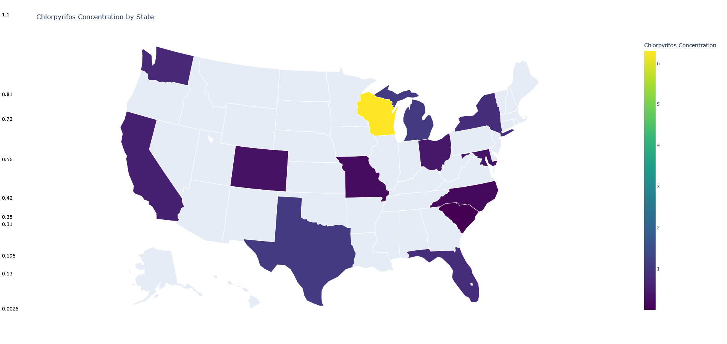
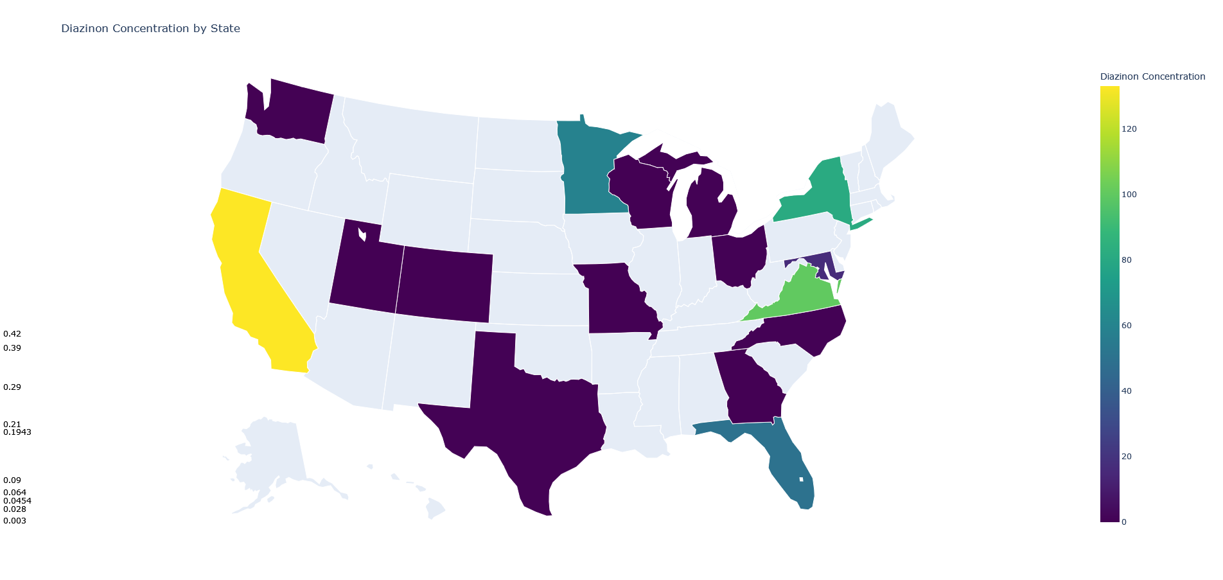
ORGANOPHOSPHATE EXAMPLES
Fig. 7: Malathion
Fig. 8: Chlorpyrifos
Malathion is an organophosphate insecticide used for agriculture, mosquito control, and lice treatment since 1956. It disrupts insect nervous systems, causing paralysis and death, and can also affect humans and animals through inhalation, ingestion, or skin contact.
Chlorpyrifos is an organophosphate insecticide. A November 2023 court ruling reinstated previously revoked food tolerances, stating the EPA should have considered modifications. The EPA will propose a new rule for 11 specific uses while current cancellation orders remain unchanged.
Fig. 9: Diazinon
Diazinon is an organophosphate insecticide used in agriculture to control pests on crops and in cattle ear tags. Approved in the U.S. since 1956, its residential use was banned in 2004. It disrupts insect nervous systems, causing death, and is available in various formulations.

Slide 8
TYPES OF PESTICIDES / HERBICIDES
III. Herbicides
Herbicides are chemicals used to control unwanted vegetation, mainly in agriculture, to improve crop productivity.
They are also applied in forest management, urban areas, and aquatic weed control.
Herbicides work by disrupting cell division, photosynthesis, or amino acid production, or by mimicking plant hormones, causing deformities.
EPA, Environmental Protection Agency, www.epa.gov/caddis/herbicides. Accessed 6 Oct. 2024.

Slide 9
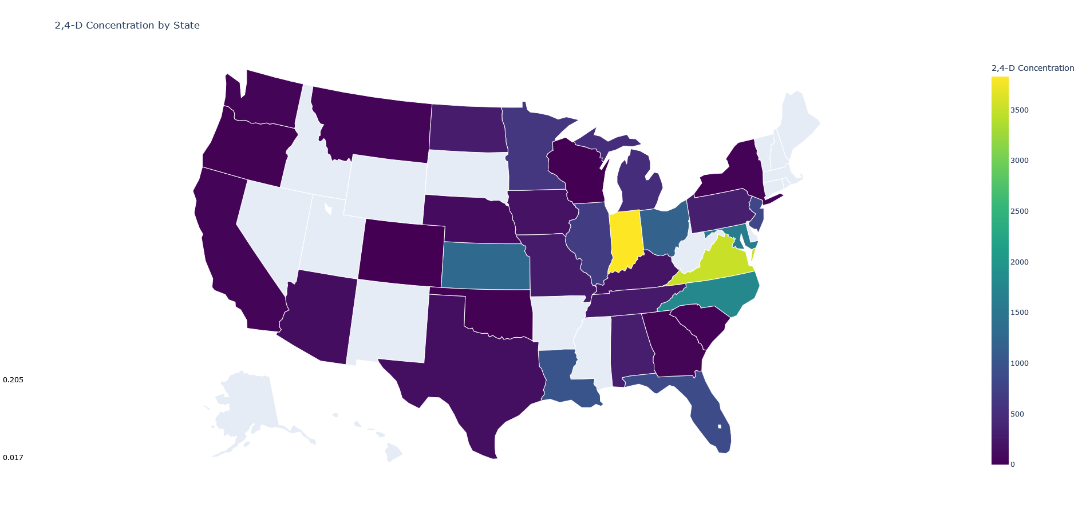
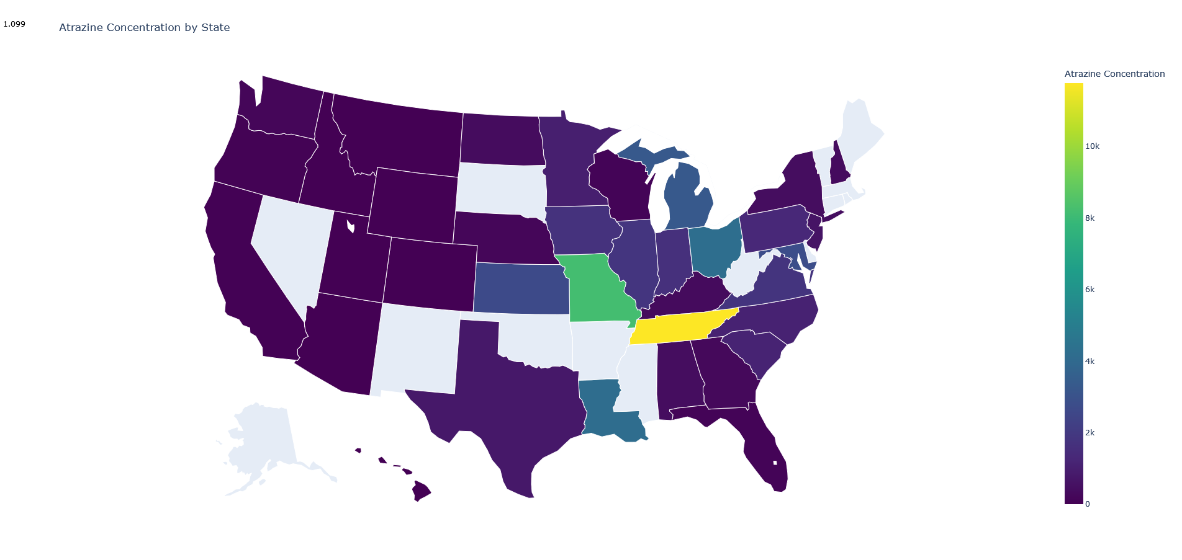
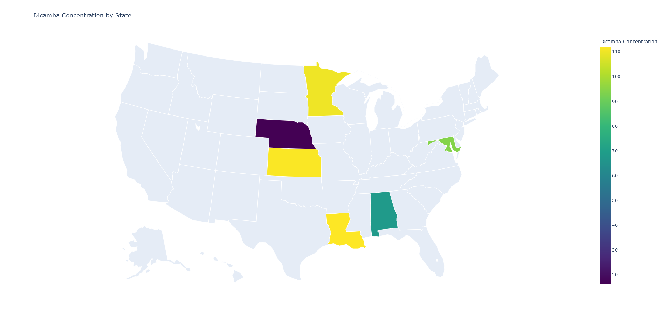
HERBICIDE EXAMPLES
Fig. 10: 2,4-D
Fig. 11: Atrazine
2,4-D is an herbicide that kills plants by altering cell growth, available in various forms with differing toxicity. First used in the 1940s, it was part of Agent Orange. It controls broadleaf weeds while sparing grasses and is found in over a thousand products. Users should follow safety instructions on labels.
Atrazine is a systemic herbicide that controls grasses and broadleaf weeds, mainly used on crops like corn and sugarcane. The EPA reviews its safety every 15 years under FIFRA, consulting with the Scientific Advisory Panel on related issues.
Fig. 12: Dicamba
Dicamba is a selective herbicide from the chlorophenoxy chemical family, available in various salt and acid formulations. It is found in over 1,100 products used in agriculture and residential areas. Dicamba disrupts plant growth by mimicking natural hormones, causing abnormal growth and often leading to plant death.

Slide 10
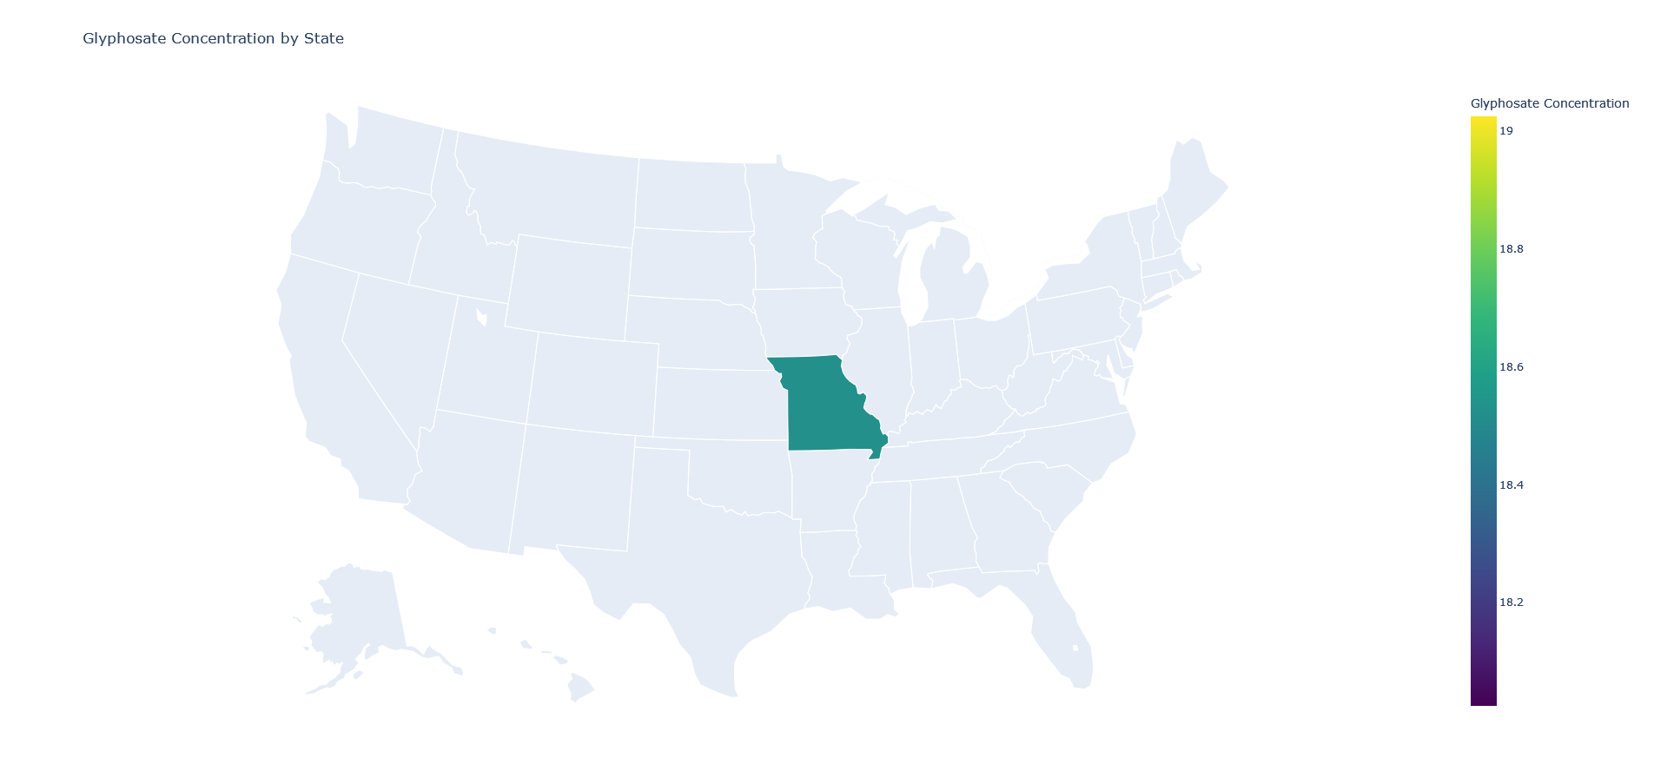
NOTABLE DATA DISCREPANCIES
European countries like Germany plan to ban glyphosate for household use, with a complete ban by year-end.
In the U.S., lawsuits over cancer risks have led to bans or restrictions in cities like Los Angeles, New York City, Miami, Austin, and Chicago.
Latin American and Asian countries have adopted varying stances on glyphosate, with some imposing and others lifting bans.
The legal and regulatory landscape remains dynamic, with ongoing lawsuits and reviews shaping future decisions.
Upon reviewing the dataset, we found that glyphosate data is limited to Missouri, unlike the broader coverage for other pesticides. This may be due to limited data availability despite glyphosate's widespread use, incomplete collection, processing errors, or differences in state regulations and reporting. Additionally, potential data biases or instances of falsification could be factors.
Fig. 12: Glyphosate
Glyphosate, the active ingredient in "Roundup," is widely used to control broadleaf weeds and grasses and was registered in the U.S. in 1974.
In 2020, the EPA confirmed that glyphosate poses no significant health risks and is unlikely to cause cancer, though it can harm non-target plants through spray drift.
A 2022 court ruling vacated the EPA's human health assessment, prompting a review of ecological risks under the Endangered Species Act.

Slide 11
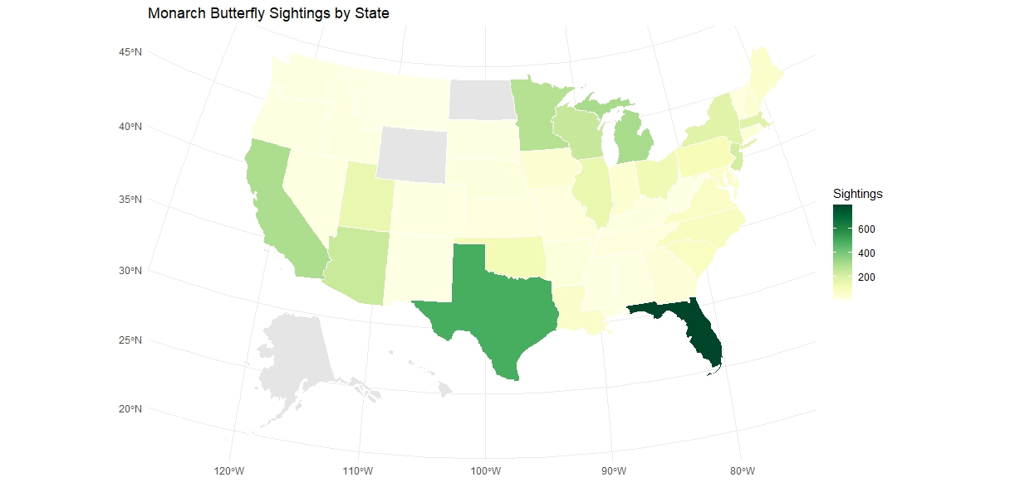
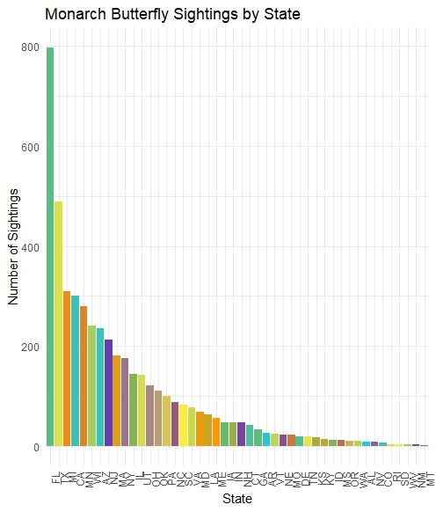
The bar plot shows the total number of monarch butterfly sightings by U.S. state, in descending order.
As seen on the map, states like Florida and Texas have notably higher sightings, shown in darker green, while other states like the Midwest and Northeast regions have moderate sightings in lighter green and yellow tones (Gray indicates no data was available).
Journey North - Query Results, journeynorth.org/sightings/querylist.html?map=monarch-adult-spring&year=2024&season=spring. Accessed 6 Oct. 2024.

Slide 12
HOW IT WORKS
Developed a program using Python and libraries like Pandas, Plotly, and Matplotlib to raise awareness about pesticide impacts on Monarch butterflies and other pollinators.
The project analyzes extensive pesticide use data across the United States, organized by state, allowing users to view pesticide concentrations.
The Python application that enables users to view the concentration of various pesticides by state.
Limitations:
USDA pesticide data is incomplete, especially for lesser-known or recently banned chemicals, with some states lacking data for certain pesticides.
Data from Journey North relies on voluntary surveys, which may introduce errors and biases, leading to an incomplete representation of the populations involved.
Instructions:
Extract the ZIP file: Extract the contents of the ZIP file to a directory on your computer.
Navigate to the directory: Open a terminal or command prompt and navigate to the directory where you extracted the files.
Run the Python script: Execute the following command to run the Python script: python PesticideMapping.py
Input the pesticide name: When prompted, enter the name of the pesticide you want to visualize. The input is case-sensitive. Some notable pesticide names you can use are Atrazine, Chlorpyrifos, Imidacloprid, Thiamethoxam, Malathion, and Diazinon.
View the map: After entering the pesticide name, a map will be generated and displayed, showing the concentration of the selected pesticide by state.
The files for this project are available on Github.

Slide 13
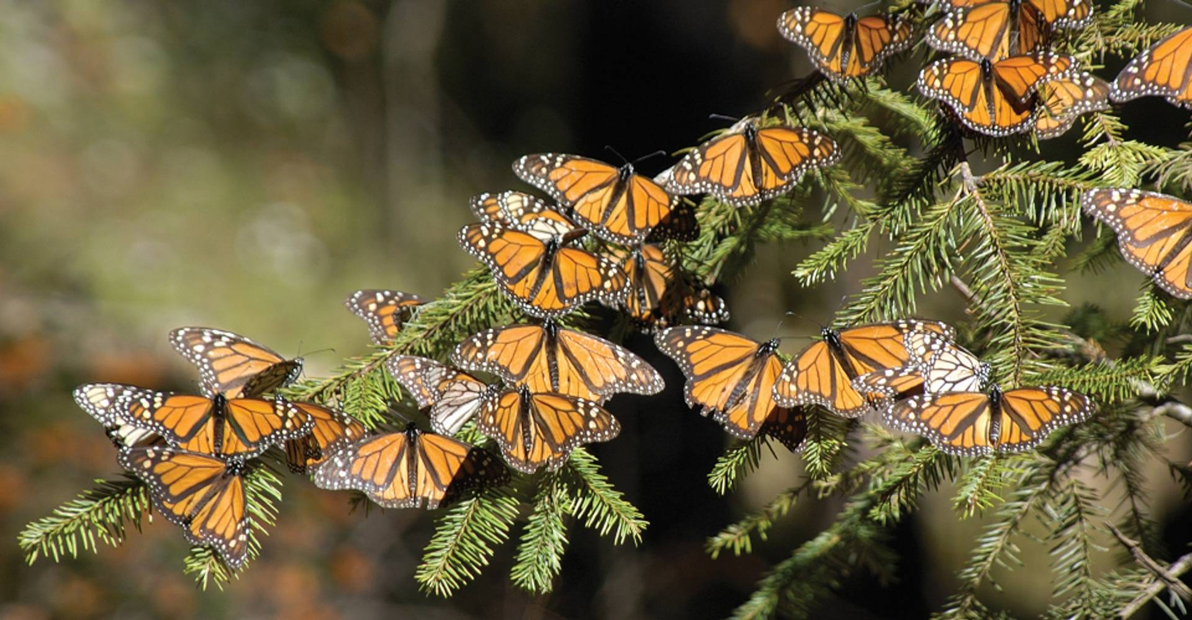
FINAL NOTE
Thank you for taking the time to review our presentation and explore our program. We hope it has provided valuable insight into the significant impact of pesticides on monarch butterflies and other essential pollinators. As we move forward, it's crucial to continue raising awareness and promoting efforts to protect these species. Every action—whether supporting pollinator-friendly practices or advocating for responsible pesticide use—contributes to the conservation of monarchs and other vital pollinators. Together, we can create a healthier environment for future generations.
“13 Facts about Monarch Butterflies in North America.” Good Nature Travel Blog | Stories Are Made on Adventures, 16 Aug. 2022, www.nathab.com/blog/monarch-butterfly-facts/.

Slide 14
WORKS CITED
“2,4-D.” National Pesticide Information Center, npic.orst.edu/factsheets/24Dgen.html. Accessed 6 Oct. 2024.
Clothianidin - DATCP - Wisconsin.Gov, datcp.wi.gov/Documents/ClothianidinCycle10.pdf. Accessed 6 Oct. 2024.
“Diazinon.” National Pesticide Information Center, npic.orst.edu/factsheets/Diazgen.html. Accessed 6 Oct. 2024.
“Dicamba.” National Pesticide Information Center, npic.orst.edu/factsheets/dicamba_gen.html. Accessed 6 Oct. 2024.
EPA, Environmental Protection Agency, www.epa.gov/ingredients-used-pesticide-products/atrazine. Accessed 6 Oct. 2024.
EPA, Environmental Protection Agency, www.epa.gov/ingredients-used-pesticide-products/chlorpyrifos. Accessed 6 Oct. 2024.
“Imidacloprid.” National Pesticide Information Center, npic.orst.edu/factsheets/imidagen.html. Accessed 6 Oct. 2024.
“Malathion.” National Pesticide Information Center, npic.orst.edu/factsheets/malagen.html. Accessed 6 Oct. 2024.
“Thiamethoxam.” National Center for Biotechnology Information. PubChem Compound Database, U.S. National Library of Medicine, pubchem.ncbi.nlm.nih.gov/compound/Thiamethoxam. Accessed 6 Oct. 2024.
“Where Is Roundup Banned?” Pintas & Mullins Law Firm, 23 Feb. 2024, www.pintas.com/lawsuit/roundup-weed-killer/where-is-roundup-banned/.
X, Science. “Glyphosate: Where Is It Banned or Restricted?” Phys.Org, Phys.org, 20 Sept. 2023, phys.org/news/2023-09-glyphosate-restricted.html.

